Slide 1
Increasing Resiliency in your student

Slide 2
Hello!
I am Bree Warner, LISW
I am here because I am the Mental Health Therapist for Maryland
You can contact me at:
Brianna.Warner@nationwidechildrens.org

Slide 3
Hello!
I am Michelle DeBellis, LPCC
I am here because I am the Mental Health Therapist for Bexley High School
You can contact me at:
Michelle.DeBellis@nationwidechildrens.org

Slide 4
Hello!
I am Jared Smith-Valentine, LPC
I am here because I am the Mental Health Therapist for the Middle School
You can contact me at:
Jared.Smith-Valentine@nationwidechildrens.org

Slide 5
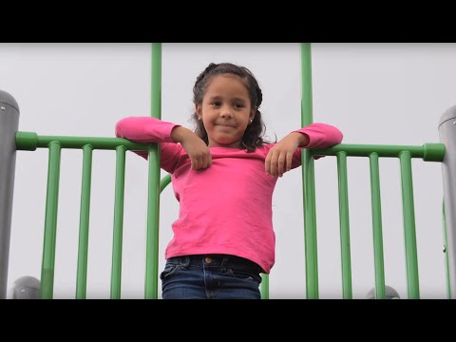
Notes:
3 min
Not all students struggle some of the barriers particularly named in this video. And even if they are not particilarly mentioned we know our students are struggling with resilency. Which we see in the rise of students who stuggle with depression, anxiety, school avoidance, and other mental health concerns.

Slide 6
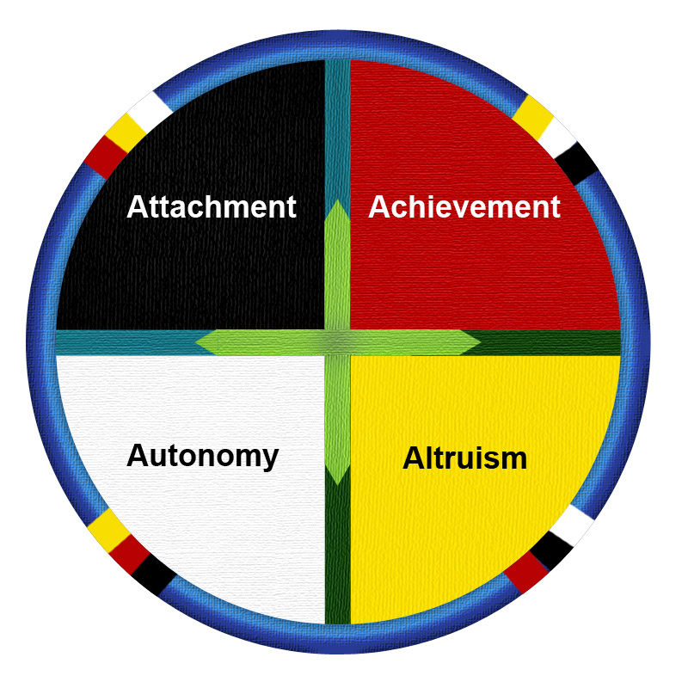
Circle of Courage
Notes:
Jared - This is the Circle of Courage

Slide 7
What is the circle or courage
The Circle of courage is a philosophical brainchild of Dr. Martin Brokenleg and Dr. Larry Brendtro
The circle of courage incorporates the concept of medicine wheels.
The Circle of Courage Identifies 4 intertwining directions that children need to develop in: Attachment/Belongingness, Autonomy/Independence, Altruism/Generosity, and Achievement/Mastery
The Circle of courage has been effectively and empirically used as a development tool since 1988 and in 2005 was integrated into the Response Ability Pathway model.
Notes:
jared
-Dr. Brokenleg and Dr. Brendtro co-created the circle of courage while studying indigenous cultures. They noticed that child rearing in these cultures produced resilient, competent adults but that these cultures used far less coercive punishment than other western civilizations. Both Doctors hold Ph.D.s in Psychology. Dr. Brokenleg holds specialization in Native American Studies, trauma, and resiliency. He is a registered member of the rosebud Sioux Nation. Dr. Brendtro holds specialization in social work and youth development
A medicine wheel is a community and ritual tool which identifies significant directions and historically was used during ritual and celebration. The Circle of courage wheel contains four important directions which represent areas of personal and community growth
Unlike other western models of development and child rearing this model includes an understanding that part of developing is developing your community and being

Slide 8
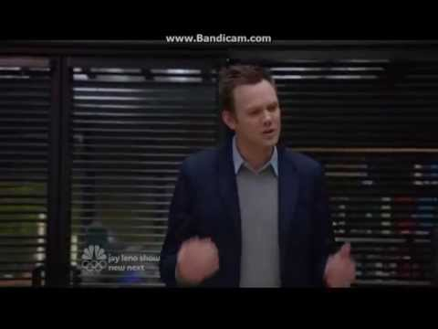
Community
Notes:
Michelle
We are going to start by looking at Attachment/ Belonging. And this video will tell us a little about what is community.

Slide 9
Attachment/Belongingness
Human beings have an innate need to feel attached and to be a part of communities.
Having secure attachment generates feelings of calmness and safety, and acts as a support for failure
Belonging to a community fosters being loving, trusting, and cooperative
What are some communities that your children belong to?
When we redirect children how do we do so without limiting belonging?
Notes:
Michelle
Attachment/Belonging is the first stage that we ever approach as human beings and regards building attachment and finding roles within communities
Kids who are not a part of their communities do not feel invested in succeeding within their communities
Kids who feel securely part of their communities are more willing to try because they have innate knowledge that they will be supported in failure
Encouraging children to identify and be loving in their communities through their service and commitment to each other within their community
Communities

Slide 10
The Pebbles and the pond
One component of teaching the circle of courage is storytelling.
The model uses oral tradition as a way to convey life lessons.
The parable of the Pebble and the Pond explains to children the power they have to impact their communities, and how that power can be both strengthening of resiliency while also being intimidating.
Notes:
Michelle - A child on a journey walks along with his guide. As they walk through the forest they come across a large clearing with a beautiful pond in the center. The child stands on the shore with the guide and looks down to his feet where he notices several stones. His guide instructs him to throw a stone into the pond. The child does so; his stone strikes the surface and begins to sink. The impact sets off rippling waves. The ripple disturbs a nearby butterfly resting on a leaf, wetting its wings the butterfly and leaf sink into the water and the butterfly drowns. Next the child notices that his stone had been a home for small mites which were now scrambling to find a new home, if they were unable to find shelter they would be eaten by larger bugs. Then the child noticed a carp which had been attracted to the surface by the sinking stone, thinking it was food. A hawk then swooped down and grabbed the carp from the water to take home to her hungry chicks. The carp flailed to escape splashing large amounts of water on the plants in the nearby shore. Then the child noticed a small wooden sign which read “do not throw stones in the pond” The child became furious with his guide “You told me to do that. My actions caused death and I only did them because you had said to. The guide asked the child “what are you feeling and thinking? And what do you want to do about it? The child fought back anger and gathered his thoughts: “I feel confused and scared. I don’t understand what happened and what was the right thing to do. I’m not sure if I should blame you or whether what happened was good or bad or both. I don’t know how I fit into all of this”. The guid responded “Did you throw the rock? And did the rock cause a rippling change?” The child replied “Yes”
“And why did you throw it?” Replied the guide
“I threw it because i hadn’t seen the sign and because you told me to do it. I would never do it again!”
“What was it that the sign had said”, the guide gestured over.
The child read the sign, this time noticing a different message “Don’t throw stones in the pond, signed carp, mites, and butterfly”... The child was in disbelief of the sign and read it again but this time it read “Please throw stones in the pond. Signed mother hawk, larger insects and plants.
The child looked down confused, feeling slightly more balance to his action “Is there ever a time where throwing a pebble would not result in a ripple?” “No” the guide replied “every time we act there is a consequence. Some will be good and some will be harmful. We will always have explanations for our action and none of them will change the ripple. Everything is explainable and nothing is excusable. We are absolutely attached to our every behavior. We own them as we do the consequences?”

Slide 11
Achievement/ Mastery
If belonging is a journey of learning to trust and love others. Mastery is a journey of learning to trust and love yourself.
Traits of a child engaging in mastery behaviors are that they are trying new things with confidence, using imagination and creating their own solutions.
Teaches child to recognize their personal strengths
Notes:
Bree-
Belongingness for yourself
Once we are in community we grow by trying new things in the community. Comes later on after children establish safety nets within the community. Ex. A kid afraid of being made fun of in the classroom, won’t be raising his hand to answer a questions
Mastry- empowers kids to impact themselves and their community
Teach children to recognize their strengths by modeling recognizing their strengths
Self-confident enough to make a change or impact on their community

Slide 12
Autonomy/ Independence
Once a child is secure in their community they begin to explore their roles within the community. This can be described as the journey for independence.
Independence is the journey of others trusting and loving us.
Independent acts not only foster our community’s faith in us but also our faith in ourselves
Even small acts of independence are important to children (line leading, completing expected work, etc.) When we praise these behaviors we encourage growth.
What sort of things do we do to foster independence within our schools and communities?
Accepting responsibility for failure is a way to increase resiliency and foster independence
Notes:
Bree
Experimenting with self-governance
Belong in the community when others love and trust us
Accepting responsibility for failure. Problem solving. Adults have a collaborative and supportive role in teaching the skills, instead of saying “you need to do XYZ to make it better” saying “ what can you do to fix it”
Tying shoes, picking clothes, small chores
example - kids forgetting lunch or book bag, parents are often jumping to bring them what they’ve forgotten, rather than allowing them to navigate the situation- school won’t let them go hungry but now they will need to eat provided lunch- will also help with natural consequences- they will eventually stop forgetting
Allowing and acknowledging failure- failure is a normal experience for all of us. Mistakes mean children (and adults) are learning.

Slide 13
Altruism/ Generosity
Decades of research on altruism has shown that acting for our communities encourages our own well-being
Research shows that our sense of morality is more a result of how we are treated than of what we are told
Relationships of empathy, capacity to give, sense of morality, compassion, honesty, fair play, and response to the needs and suffering of others (Wolin & Wolin)
How do we as parents, as a school, and as a community build altruism in our children?
Notes:
Jared- Emotional generosity, being forgiving and monitoring our patience with others. Generosity is largely learned behavior from modeling. In what ways can a child be generous? (patience, time, energy)

Slide 14
Coercive vs restorative
Physical Coercion
Punishment
Deprivation
Restraint
Emotional Coercion
Threat
Hostility
Blame
Social Coercion
Exclusion
Frustration
Domination
Unconcern
Physical Support
Protection
Nurturance
Freedom
Emotional Support
Trust
Respect
Understanding
Social Coercion
Belonging
Mastery
Independence
Generosity
Notes:
jared

Slide 15
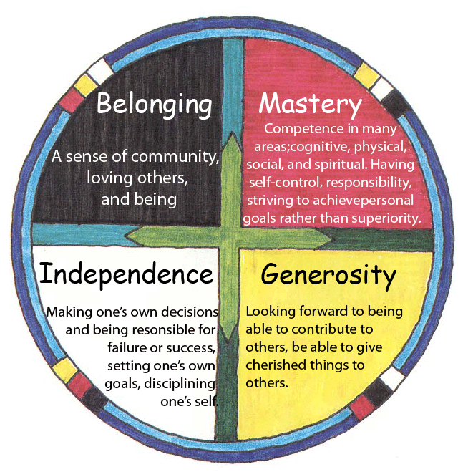
Intertwining
The directions of the circle come back toward each other, leading into and impacting each area.
Children who grow in all of these areas thrive because each skill set feeds into and impacts the others.
Notes:
Michelle
The circle of courgae does not make each piece function independetly. Chlidren need all aspects of the ciricle of courage to thrive. Each piece of the circle connects and moves towards all the other parts of the circle.

Slide 16
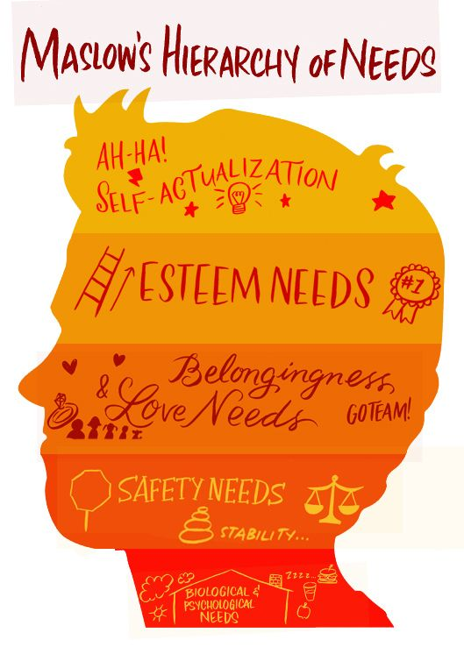
Notes:
Michelle
The circle of courage also relates to the innate needs for human development represented in maslow’s Hierarchy of Needs. The first piece fo the circle we talked about (Attachment and Belong) exist in the safty needs and love levels of Maslows hierarchy. And every other part of the circle is in the esteem needs and self-actualization. When working with students and kids it is first important to establish basic needs being met and saftey before we can expect them to develop all the areas in the circle of courage.

Slide 17
Tips & Tricks
Don’t accommodate every need
Avoid eliminating all risks
Teach them to problem solve
Teach concrete skills
Avoid “why” questions, instead ask how
Use “I’m not sure, how should would handle it?”
Avoid catastrophizing
Let your kids make mistakes
Help them manage emotions
Model Resiliency
Notes:
Bree
Accommodating every need gets in the way of children developing their own problem solving and mastery skills. Parents never want their children to be uncomfortable, but removing all discomfort also removes their chances to handle the emotion in healthy ways.
Parents also want to keep their children safe, and while we are not encouraging putting them at risk, they must also learn how to set their own limits. Allowing some risks allows them to develop the skills to look after themselves and learn safety skills on their own. For example; helping them learn to cross the street and look both ways; some risks but they are learning how to be safe
Taking the time to problem solve with your children helps them figure out how to navigate situations. Collaborating with them and brainstorming potential solutions gives them more mastery on handling issues on their own, even when you are not around.
Think about specific situations you and your child will encounter together, now think about the skills they need to navigate that situation. For example, teaching how to introduce themselves to someone,
It’s tempting to question the why behind your child’s actions. For example, WHY did you leave your bike out in the rain? Instead asking them how they can fix or handle the situation fosters their ability to problem solve
Avoid providing all of the answers. This is one that might annoy the kids- but again models and promotes problem solving skills. Using “I’m not sure” or “I don’t know” wiht a statement suchs as “what should we do” “how could we handle it” or “how can we find out” helps prepare kids for uncertainty and assists them in finding answers on their own
We want our children to understand the importance of safety and why things need to be taught or caution used. A balance is necessary to convey the need for safety while not instilling fear. For example “you need to look both ways before crossing the street” rather than “you need to look both ways before crossing the street because if you don’t you will get hit by a ca and I will be devastated because you will die”
“Failure is not the end of the world. [It’s the] place you get to when you figure out what to do next,” Lyons said. Letting kids mess up is tough and painful for parents. But it helps kids learn how to fix slip-ups and make better decisions next time. - Parents often want to make sure projects and what their kids are doing are perfect. Letting them make mistakes allows opportunity to learn consequences of those mistakes. They aren’t always negative!
Emotional intelligence fosters resilience. ALL emotions are ok and normal. I’m sure many of you have seen the movie inside out with your kids, fear, sadness, and anger are just as important as joy. Teaching kids how to handle those big emotions now ensures they will be able to handle them as adults and identify the behaviors that are acceptable for those big feelings. For example, it’s ok to be angry not to get ice cream, but throwing a kicking, screaming, stomping tantrum over it is unacceptable behavior, so what can we do instead?
Kids learn from observing their parents behaviors. You cannot say to your child you want them to control their emotions while you yourself are flipping out. Try to be calm and consistent. Obviously we are still humans, if you do have a moment and your child sees or hears it- acknowledge it and discuss with your child what you could do differently

Slide 18
Circle of Courage Activity

Slide 19
Resources
Books
The Gifts of Imperfect Parenting by Brene Brown
The Optimistic Child by Martin E. P. Seligman Ph.D.
The Orchid and the Dandelion by W. Thomas Boyce
Response Ability Pathways by Larry Brendtro and Lesley Du Toit
How to Raise an Adult by Julie Lythcott-Haims
Articles
The Atlantic- The Coddling of the American Mind
Michigan State University - Wholehearted parenting: Raising kids with courage and resiliency
Psychology Today-4 Ways to Build Resilience (All Kids Are Not the Same)
Psychology Today- Adolesence: Designed for Failure, Recovery, and Growth
Podcasts
Invisibilia- The Fifth Vital Sign
Experts on Experts - Jonathan Haidt
Fresh Air - Is Your Child An Orchid Or A Dandelion? Unlocking The Science Of Sensitive Kids
NPR - To Raise Confident, Independent Kids, Some Parents Are Trying To 'Let Grow'
Notes:
Michelle

Slide 20
Questions?

